Slide 1








NOTICE:
This package most likely doesn’t
contain wasps, hornets, and/or bees.
NOTICE
Contains RFID
and GPS Tracking
I do not fucking
care for your shit
Warranty VOID
if not removed
ATTENTION:
Some advertised claims are only valid if
intoxicated and/or under the influence of
very strong psychoactive substances.
Officially sanctioned
DEFCON shenanigan*
!
We’ve been trying to
reach you about your
car’s extended warranty
These materials may
have been obtained
through shitposting
*Not really, but Noid said we could do it, it was cool
Want to be a crab?
Ask me how TODAY!
TAP for accelerated
identity theft
Please don’t click
all the things
This is a sticker

Slide 2





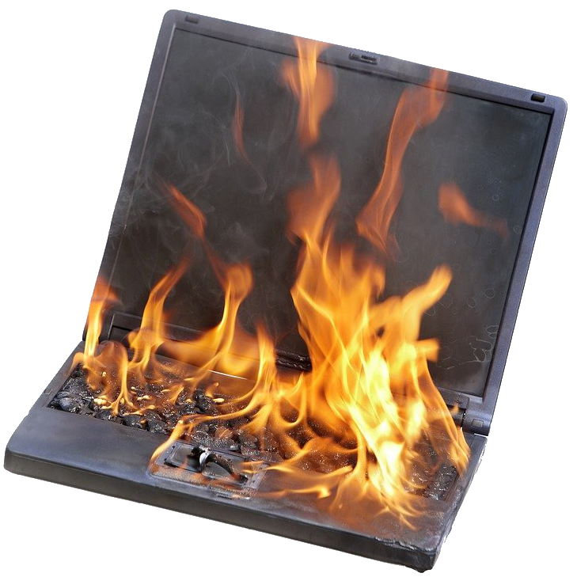

WARNING!
Test that assumption at
your earliest convenience
I got blocked!
Find out how today!
Please obey all laws of physics, time,
and space or face criminal charges
including fines and/or jail time
WARNING!
Please avoid contact with
holy water and anyone that
uses ketchup on steak
This product contains portions
of SCO Unix, please use with
extreme caution!
STFU and go
finger paint
It gets worse
#DuckArmyInvasion
Some people appear to
have bad luck when it
comes to critical thinking
Caution
Extreme Chaos Area
before it gets worse

Slide 3


DO NOT USE
RECALLED
DELAMINATION ISSUE
DANGER
Godzilla Hazard
To err is human.
To really fuck things up,
you need a computer.
NO EYE CONTACT
$500 FINE
Pretend to read the directions
carefully and do whatever the
hell you think might be the
right way and then whine
about why it doesn’t work.
WARNING!
Please use extreme caution when
Yeeting scooters off the bridge

Slide 4








WARNING!
Please use cinder blocks when
Yeeting developers off the bridge
Please only yeet Anti-vaxxers
in to active volcanos only!
THIS MACHINE
WILL BE USED
FOR GOOD AND EVIL
The League of
Extraordinary
Shitposters
The League of
Extraordinary
Shitposters
Please don’t click
all the things
The League of
Extraordinary
Shitposters
The League of
Extraordinary
Shitposters
Shove as many
bees into your
mouth as you
possibly can
Or just turn off AirDrop

Slide 5

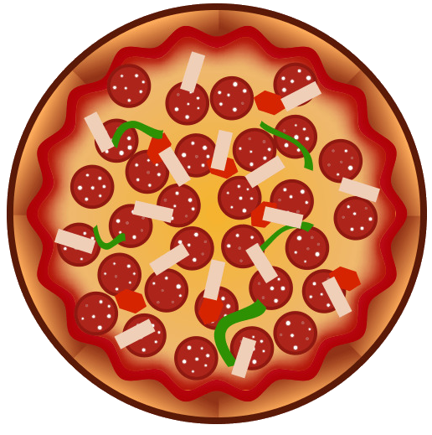





Remember once you address root cause and make
it so that will never happen again, something will
happen to where you need to do the thing that you
shouldn’t do any more.
Just roll the whole
thing up into a giant
pizza cigar and eat it
like a caveman
-@dildog reacting to the horror that is tavern style pizza
Shove as many bees into your
mouth as you possibly can
Remember:
Only you can prevent zero-day
disclosures if you pay
DON’T FORGET
OPEN BAR – FREE FOOD
10PM UNTIL ????
BarnCon 1
November 13th 2021
“It’s like Skytalks,
but in a barn”
Backdoors:
Not just a bad idea,
an incredibly stupid idea.
?
Just because you can
do a thing, does that
mean you should?
So you put the DC in the
DMZ to make it easier?
FOR WHAT??

Slide 6



IF FOUND, DROP IN ANY MAILBOX
RETURN POSTAGE GUARANTEED
NO. 223934
PROPERTY OF
FBI SURVEILLANCE VAN
NO. 17
It’s a
Pirate Hat.
THIS MACHINE
CAN BE USED
TO DECODE HTML
With Extreme
Customer
Service
[ tense music continues ]

Slide 7

Troubleshooting
checklist
Applications
VOICE
ACTIVATED
Servers
THIS SERVER
MAY CONTAIN
CRYPTOCURRENCY
Networking
Yes, this includes DNS
SAY LOUDLY
“PAPER TOWEL
NOW!”
NOTICE:
This is now an NFT, it can be located on the blockchain.
DO NOT REMOVE THIS STICKER

Slide 8



Buy an NFT?
I’ll fucking
do it again
No
Fucking
Thanks
BOOSTED!
Sponsored by ^C/^V
Buy an NFT?
No Fucking Thanks
Sponsored by ^C/^V
CORN

Slide 9










STOP! This is now an NFT, it can be located on the blockchain.
DO NOT PHOTOGRAPH OR SCREENSHOT
WARNING:
The software installed on this device
is only used to simulate security and
will provide no protection.
4
4
NFT and Blockchain hucksters
will be launched into the Sun
Log4Shell:
Making Xmas a living hell
Please take me
away now
Remember the company motto:
It’s better to burnout
and throw away
When the clouds go away,
it’s just a nice sunny day…
except in IT

